Slide 1

Cat Map
Vandan Amin, Chaker Baloch, Devlin Hamill, Eli Holter, Krai Pongrapeeporn, and Austin Sill

Slide 2
Team Introduction
Vandan Amin (Front-end Lead Developer)
Chaker Baloch (Back-end Lead Developer)
Devlin Hamill (Project Management)
Eli Holter (Documentation Lead)
Krai Pongrapeeporn (Documentation)
Austin Sill (Communication Lead)

Slide 3
Introduction
Our project is to create a campus navigational aid app designed for CWU students. This will allow them to navigate to their next classes and allow the user to save events and classes as part of their schedule. The user will visually be pointed towards a designated path on the CWU map to their upcoming events and classes. Users will also be able to save favorite locations through searching for them with a favorites tab. ​ ​ ​

Slide 4
Scope
Things that MUST be in the app
An intractable graphical user interface (GUI)
A map of the CWU campus
User profile functionality
Sign-in and sign-up pages
The user’s schedule
A favorite locations page
Map based scheduling
Notifications for upcoming classes
App generated directions/pathing used by the user to find the buildings for the classes in their schedule
Modification support such as added, editing, and deleting specific parts of the schedule.
The daily schedule that displays the user’s classes, buildings and times.

Slide 5
Scope Continued
Things that must NOT be in the app
A map of the entire world will not be provided
Directions to places outside the campus will not be used
Addresses will not need to be taken into consideration.
Google street view will be unnecessary.
Buildings outside of the campus will not need to be visualized.
Times outside Ellensburg’s time zone will not be provided.

Slide 6
Diagrams
UML and Timeline

Slide 7
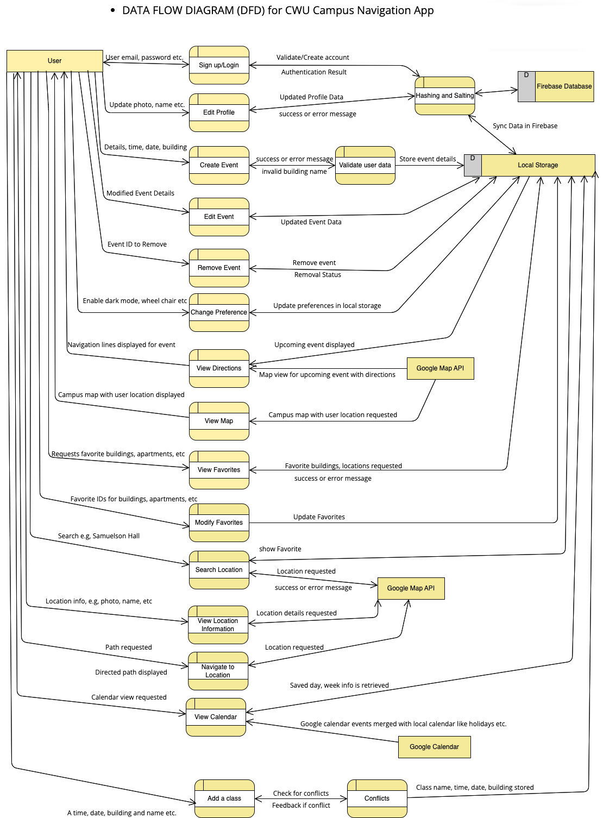
Dataflow Diagram

Slide 8
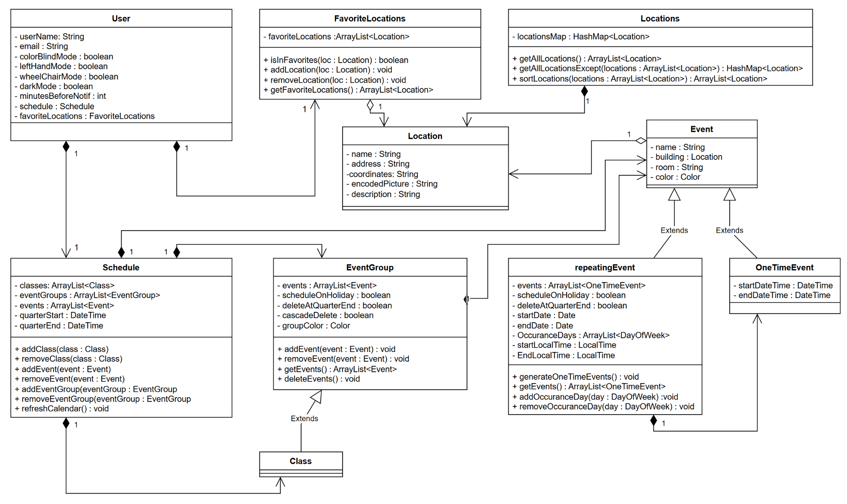
Class Diagram

Slide 9
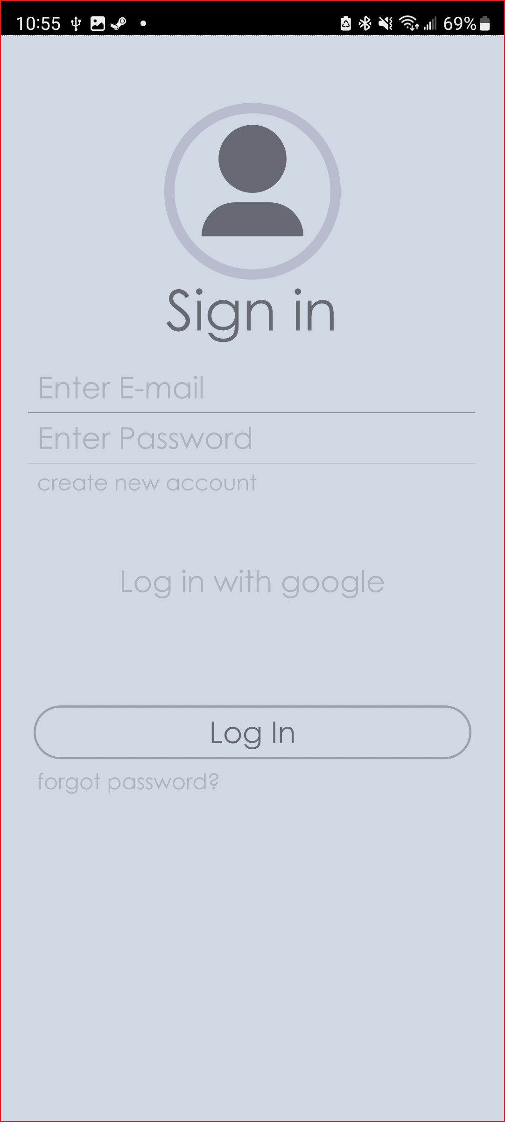
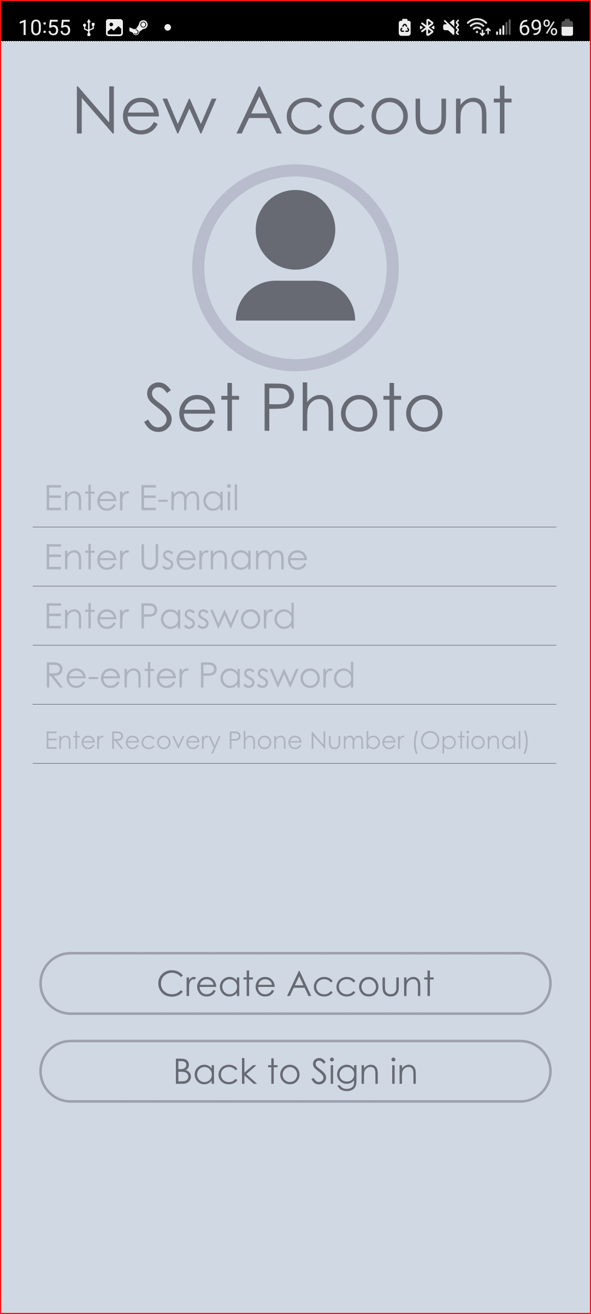
GUI

Slide 10
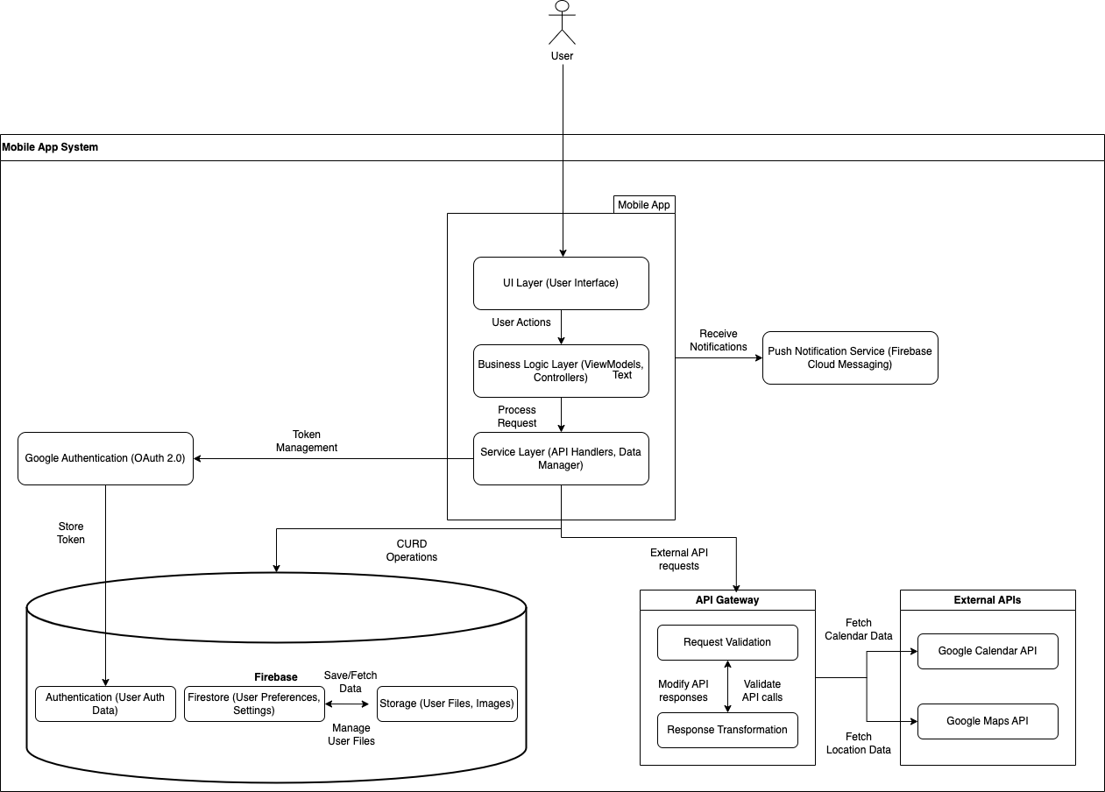
Software Architecture

Slide 11
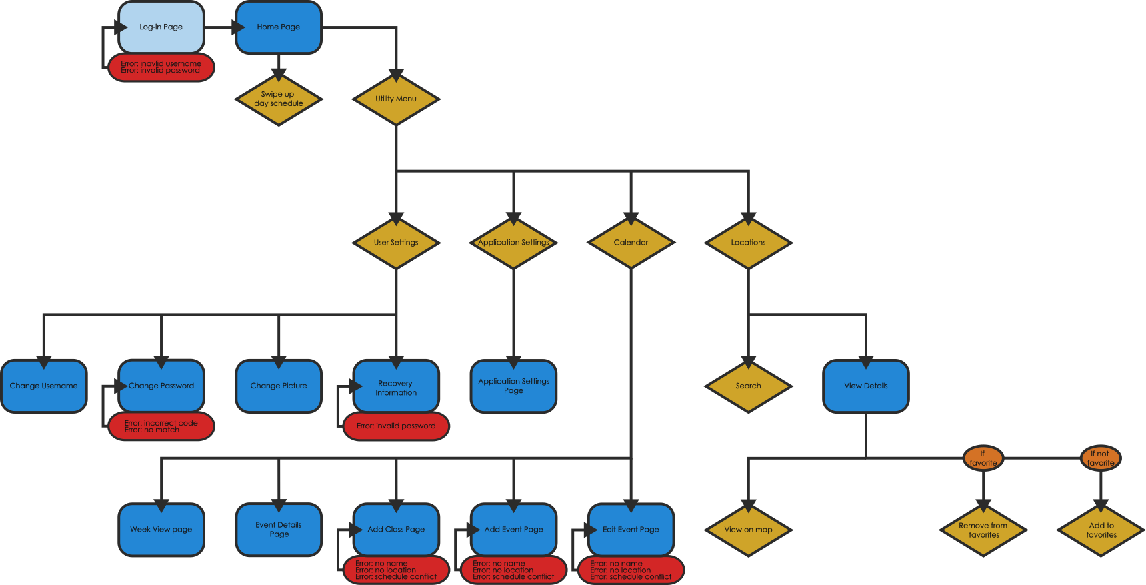
Navigational Flow Diagram

Slide 12
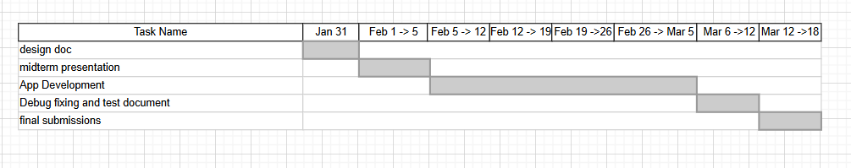
Timeline

Slide 13
Requirements
Organized By Use Case

Slide 14
User Account
Sign Up
User can sign up with email address or "log in with Google"
Email address must not already exist within the database
Automatically log user in on successful account creation
Log in
User can log in to existing account using email address or "log in with Google"
Logging in with "log in with Google" will create an account if none exist
Log Out
User can log-out of any type of account
Automatically delete session token on successful log out
Multiple Log-In
User will be able to log-in to multiple devices each with their own token

Slide 15
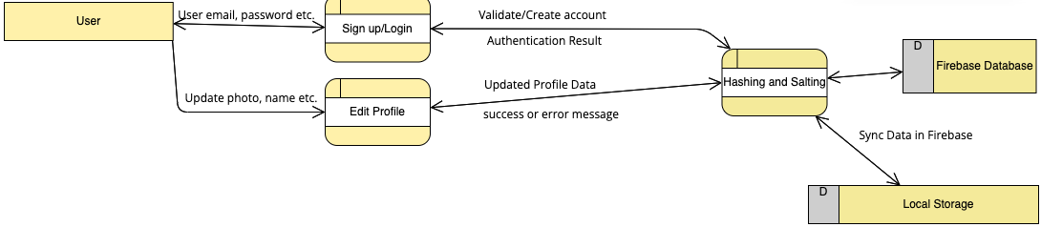
Software Implementation

Slide 16
User Profile Continued
Edit Profile Picture
User can add or change their profile picture
Use camera or photo library to get new photo
Google accounts will pull picture from Google account
Edit Name
User can change their name
Google accounts will pull name from Google account
Edit Email
User can change their account username
New email address will be validated before acceptance
Not possible for Google accounts
Edit Password
User can change their password

Slide 17
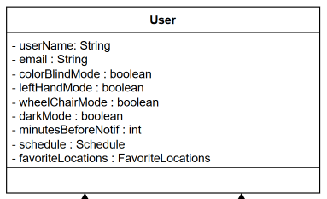
Software Implementation

Slide 18
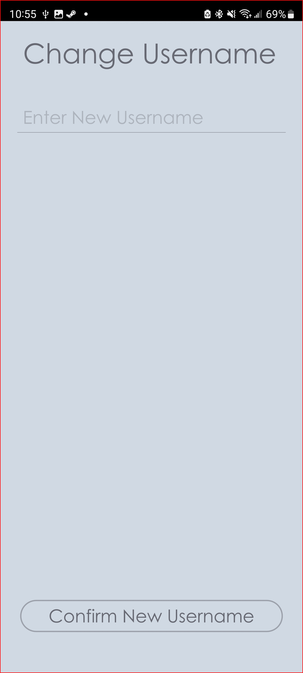
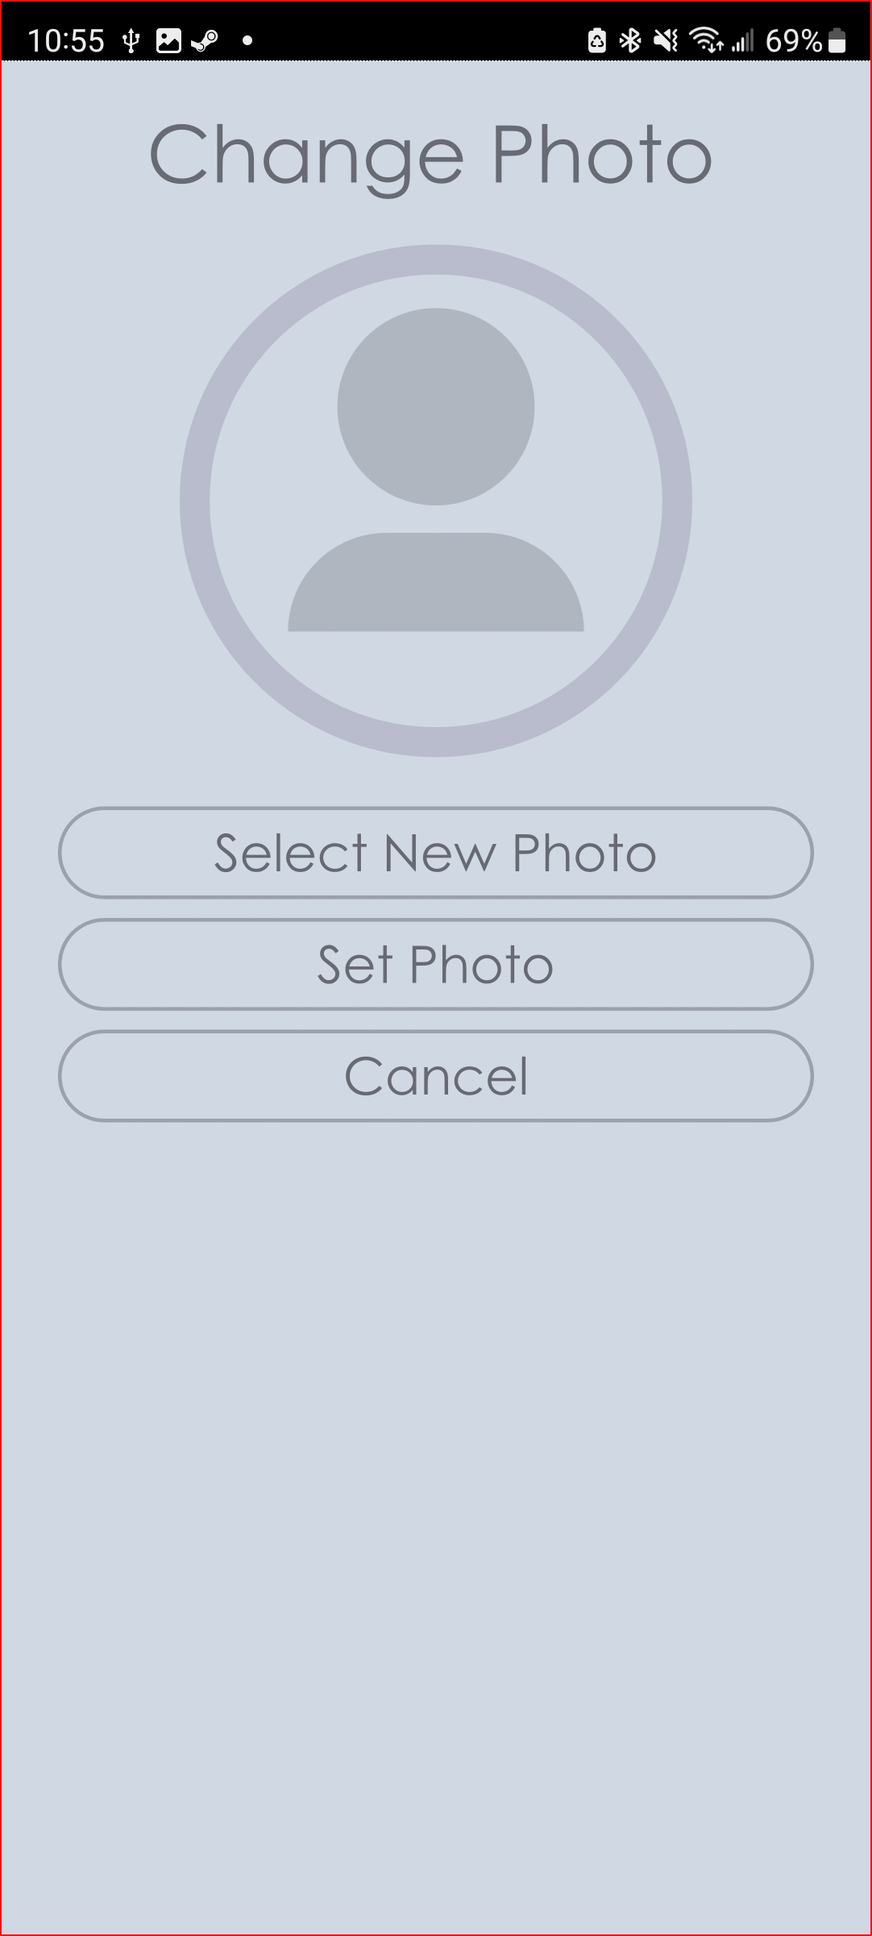
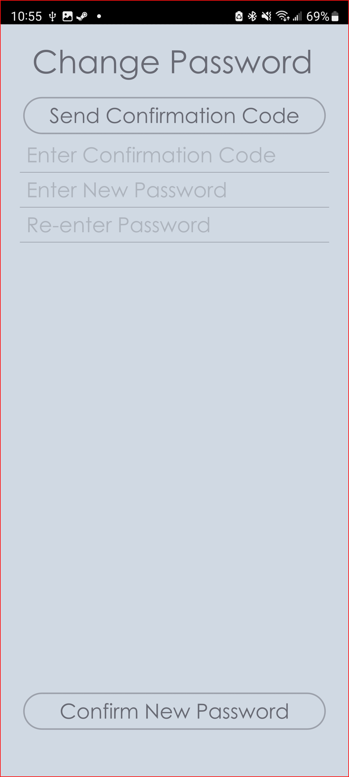
GUI

Slide 19
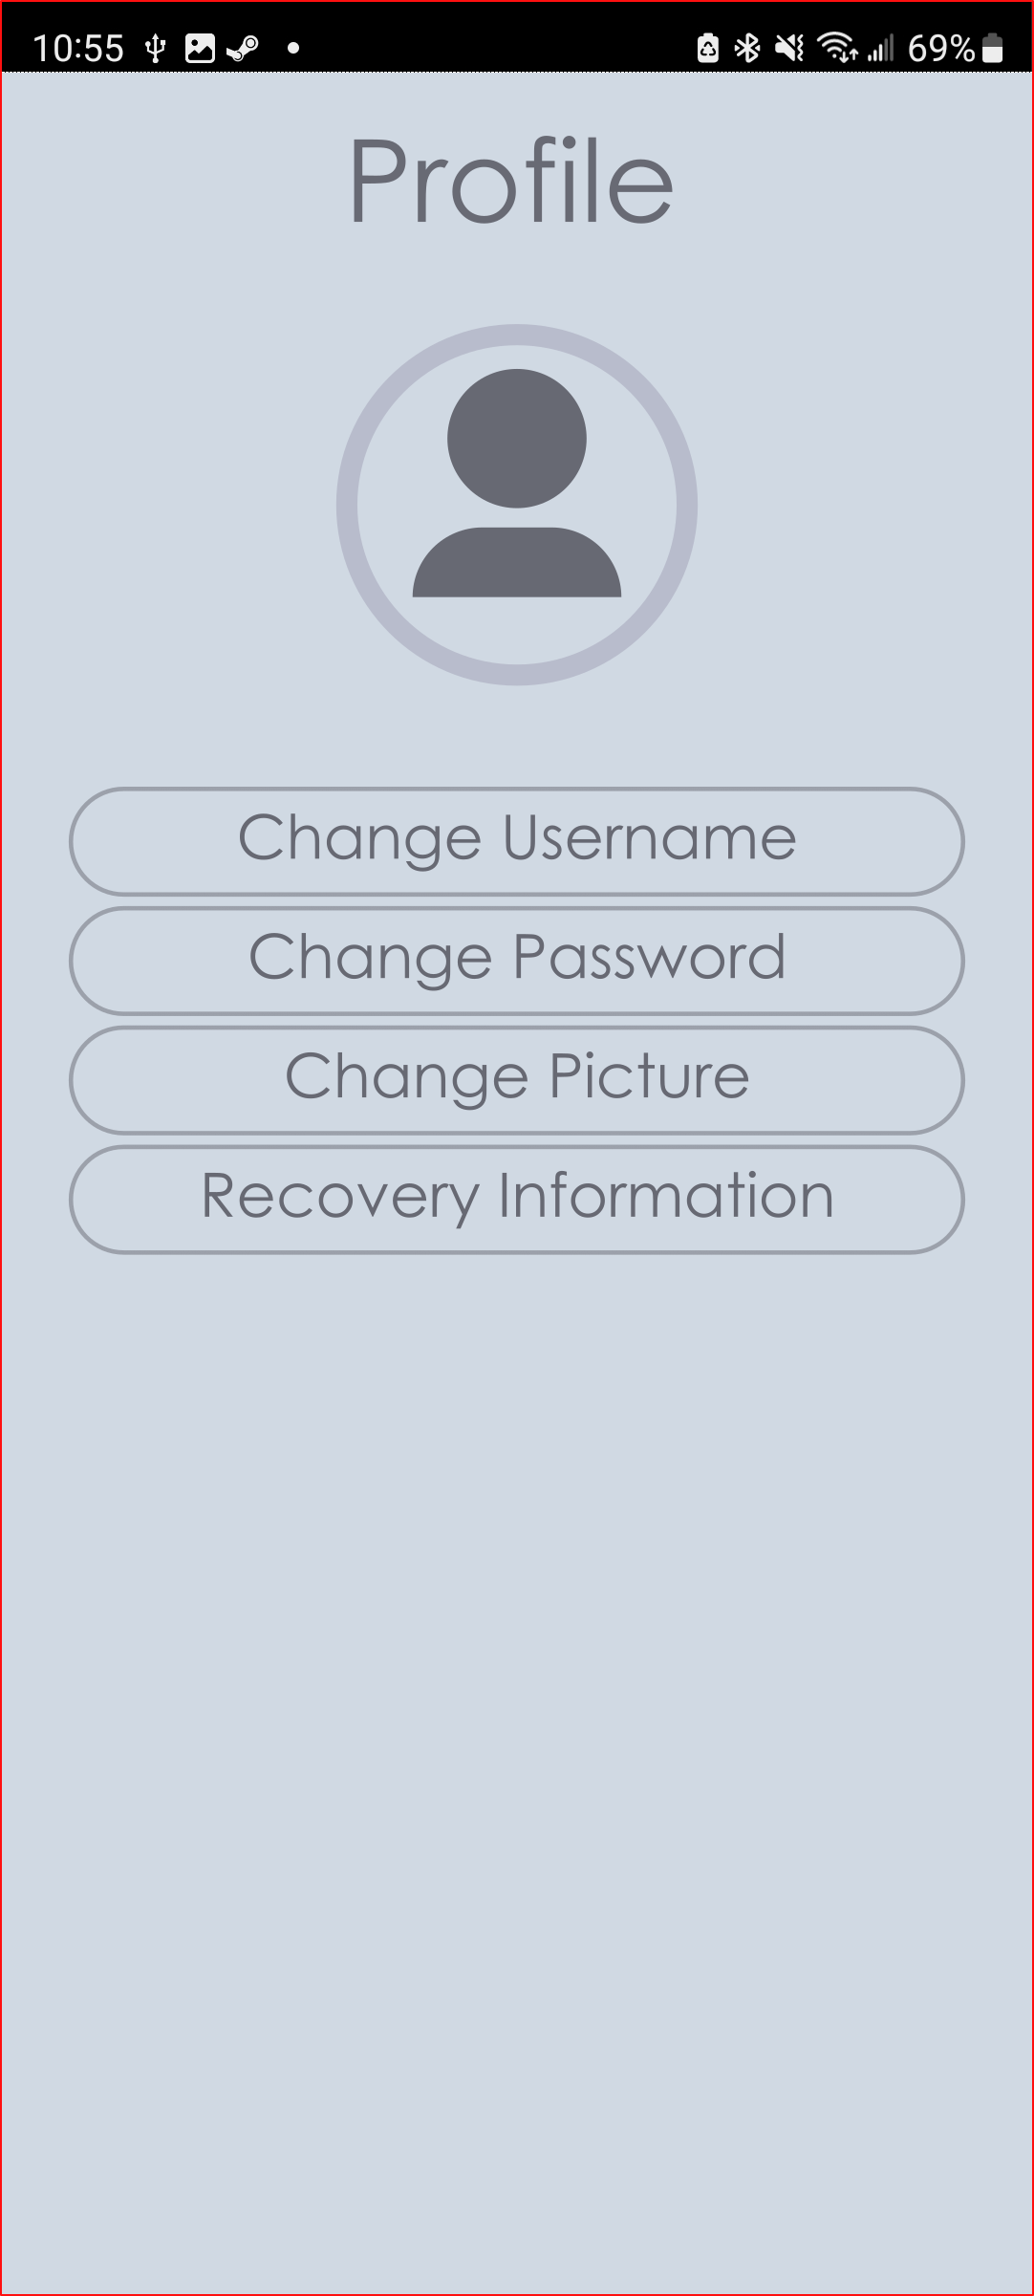
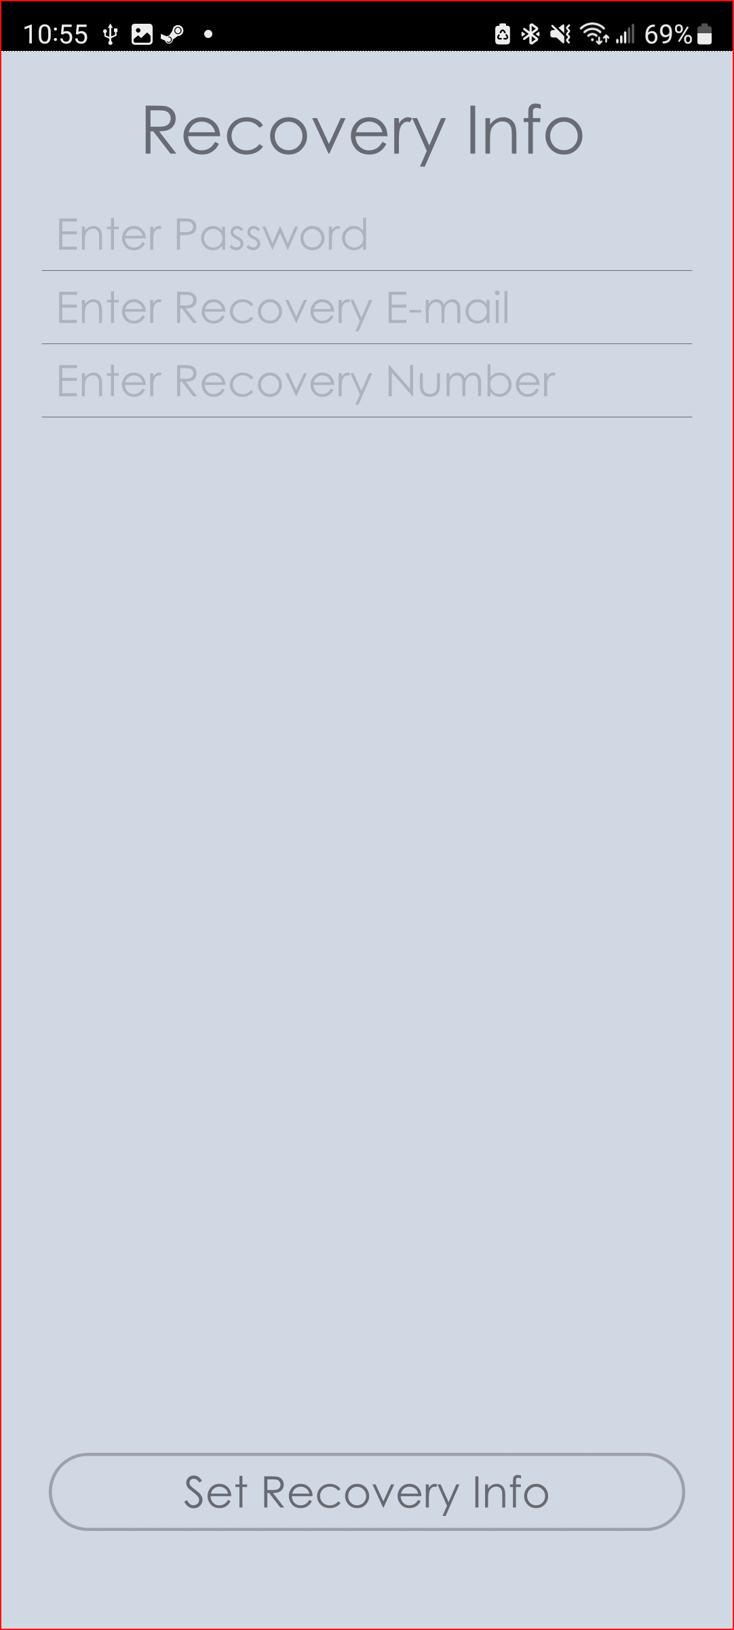
GUI

Slide 20
App Settings
Theme
User can choose between app themes, standard being light and dark
Handedness
User can change their handedness which will change which side of the screen some icons appear on
Accessibility
User can change their mobility settings, forcing path-finding to use specific accessible building entrances
User can change app color palette for color blindness
Notifications
User can change what type of notifications are sent and when they appear

Slide 21
Software Implementation

Slide 22
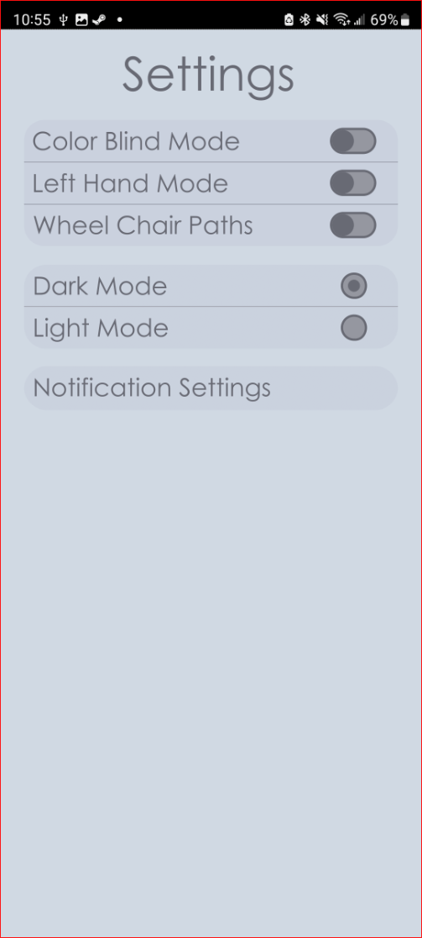
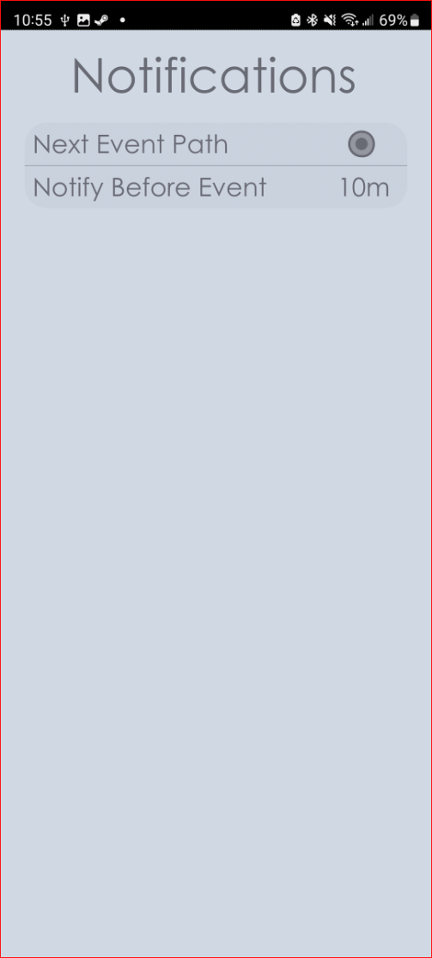
GUI

Slide 23
Map and Navigation
Map
User can see a top-down map of the CWU campus
Pin pointing to user location
Pin pointing to current destination
Optional Pins
Pin pointing to all locations of scheduled events for current day
Pin pointing to all favorite locations
Path
User can see a path from their current location to their destination
Dotted line routing from user location to next intermediate destination if one (or many) is selected
Solid line routing from user location (or last intermediate destination) to next scheduled class or event

Slide 24
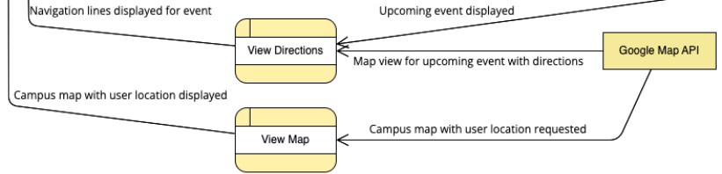
Software Implementation

Slide 25
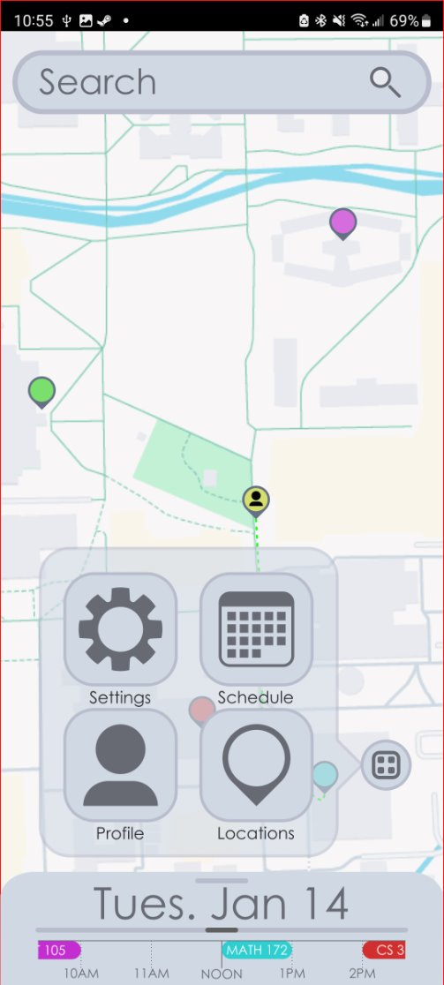
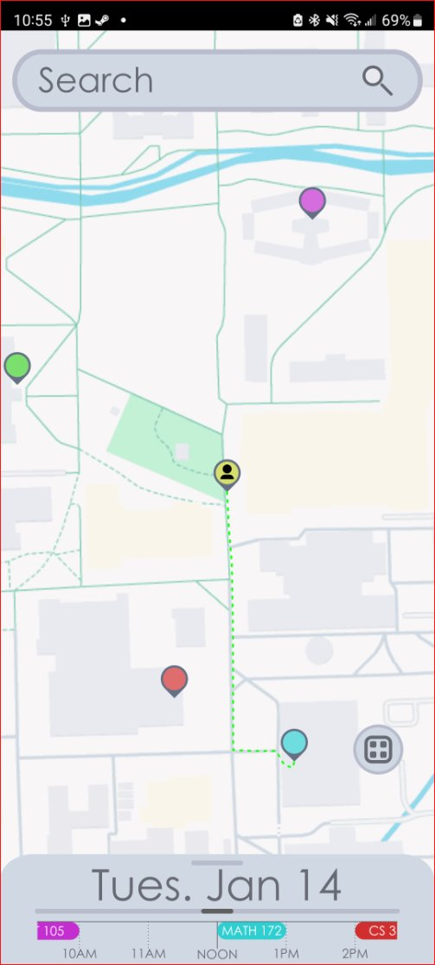
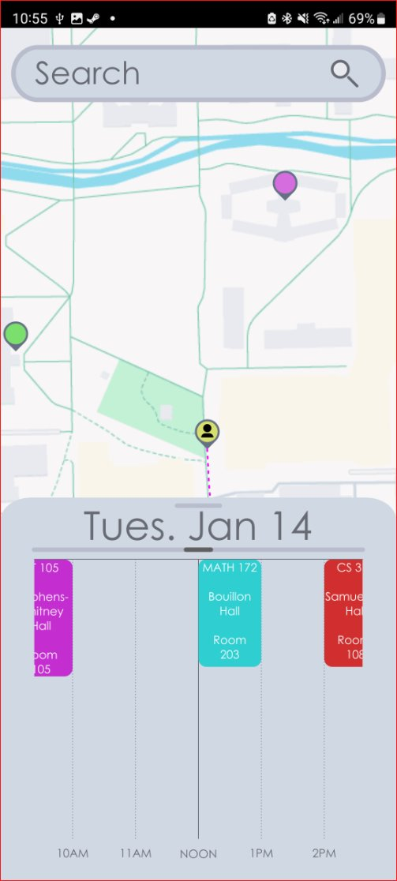
GUI

Slide 26
Locations
View All Locations
User can view all locations on campus using the locations screen
View Location Information
User can click a location on the locations screen to see more information about it
Search Locations
User can search for a specific location using the search bar
Search bar will be visible on the map screen and the locations screen
Clicking the search bar on the home screen will take the user to the locations screen
Navigate to Location

Slide 27
Favorite Locations
View Favorite Locations
User can view their favorited locations
Add Location to Favorites
Use can add a location to their favorites using the location information screen
Remove Location from Favorites
User can remove a location from their favorites using the location information screen

Slide 28
Event Groups and Classes
Create New Event Group
User can create a new event group or class to organize events
Names must be distinct between event groups
Edit Event Group
User can edit all information about an event group
New event names will be validated before approval
Remove Event Group
User can remove an event group
Deleting an event group will either delete all events within the group or just un-group them depending on user input provided during creation and editing
Notes:
Mention event groups and classes are only marginally different so we can treat them the same when discussing use cases

Slide 29
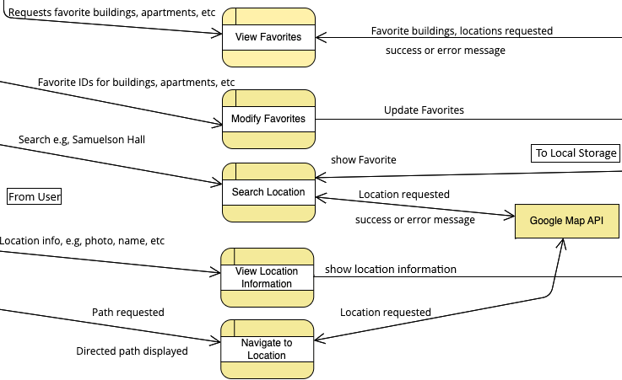
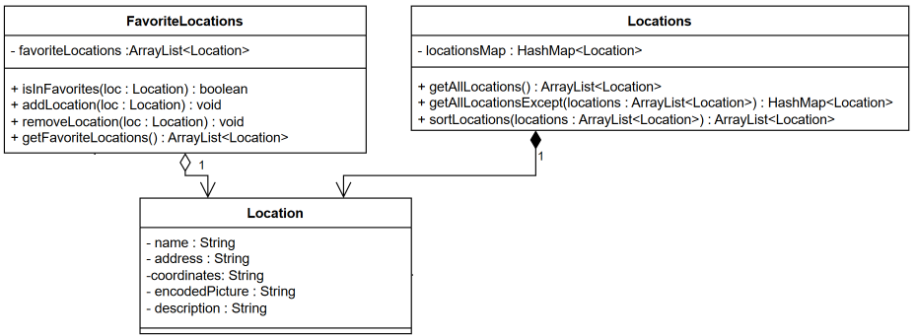
Software Implementation

Slide 30
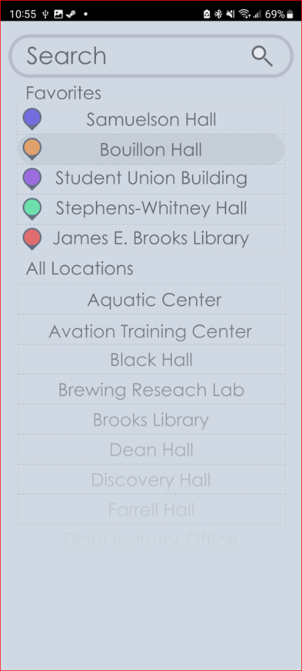
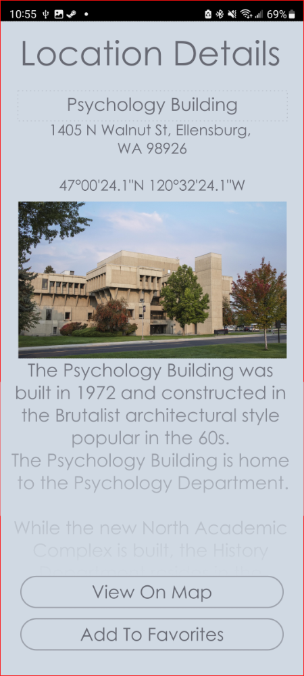
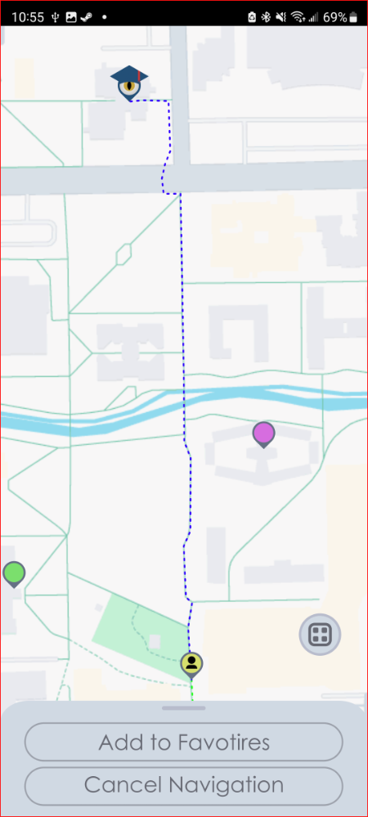
GUI

Slide 31
One-time and Repeating Events
Create Event
User can create a new event and add it to their schedule from the schedule screen using the event creation screen
App will notify the user of time conflicts after adding
Edit Event
User can edit all information about an event using the event information screen
App will notify the user of time conflicts after editing
Remove Event
User can remove an event from their schedule using the event information screen

Slide 32
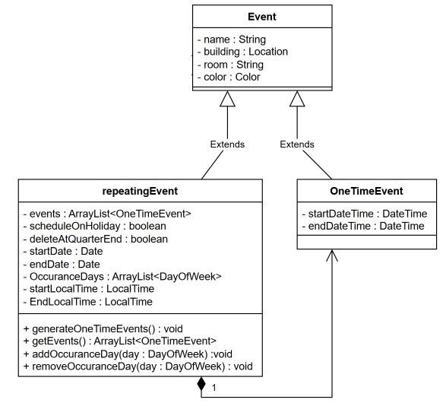
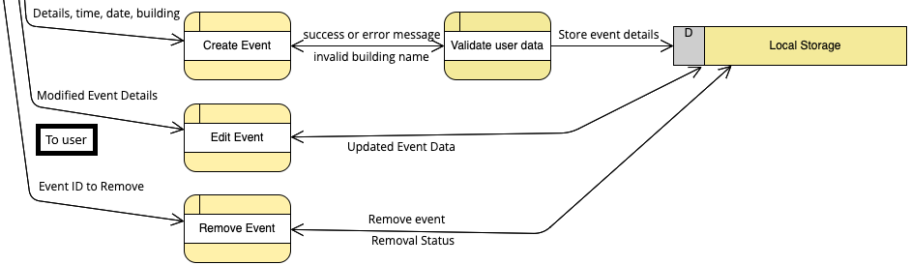
Software Implementation

Slide 33
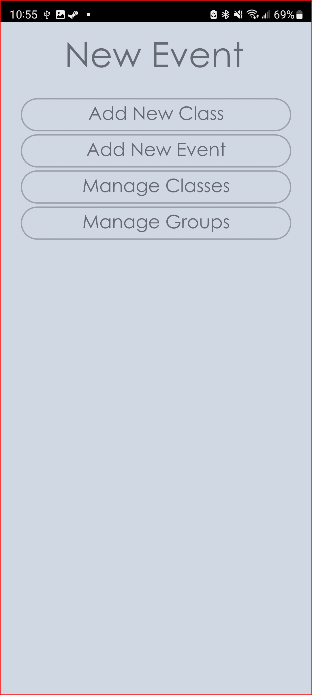
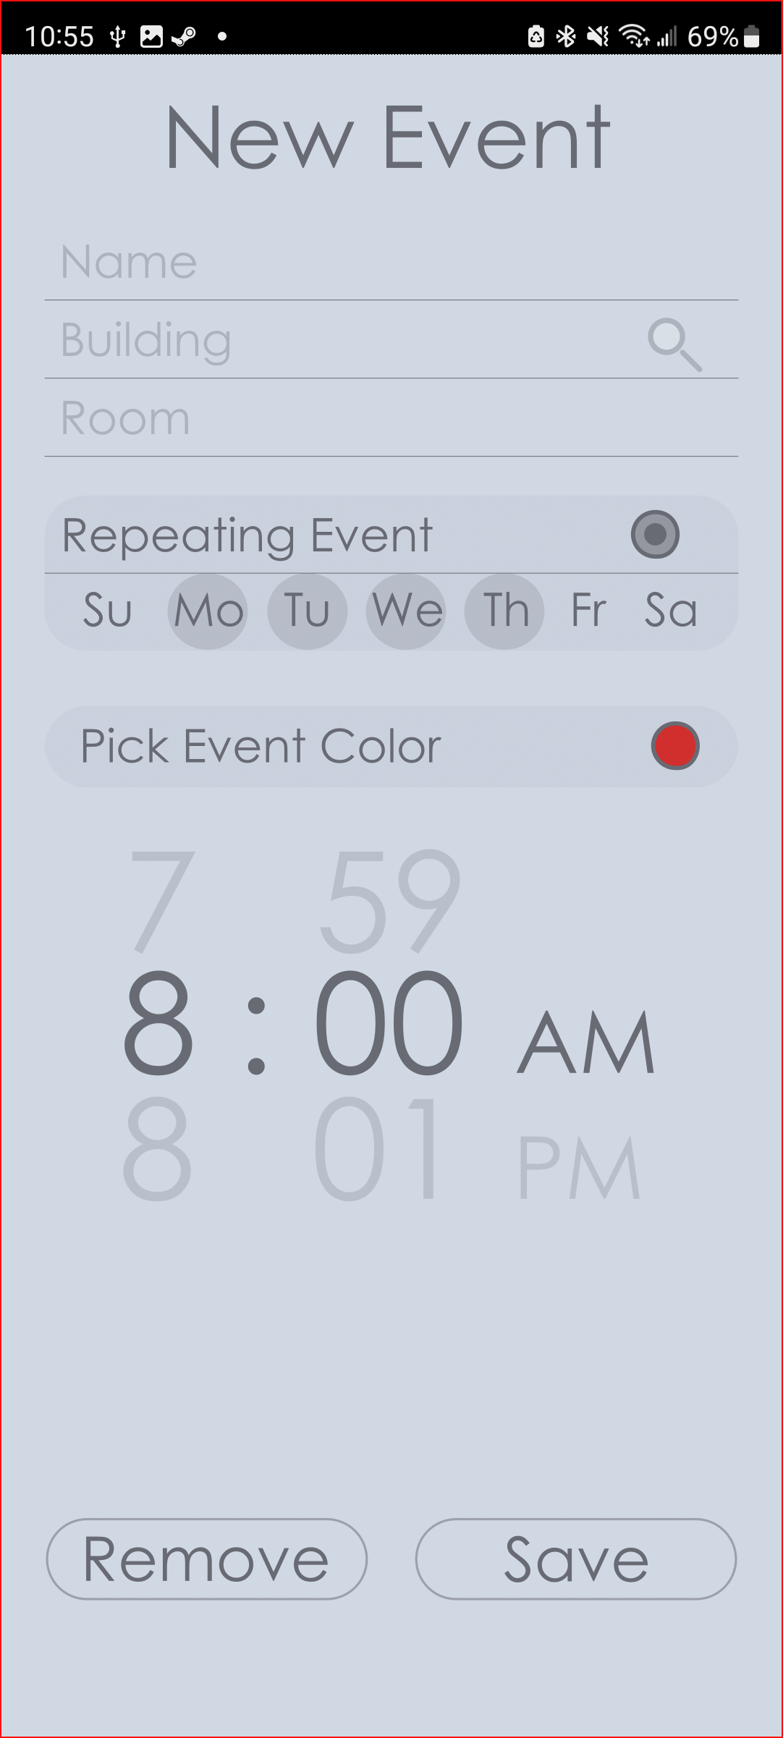
GUI

Slide 34
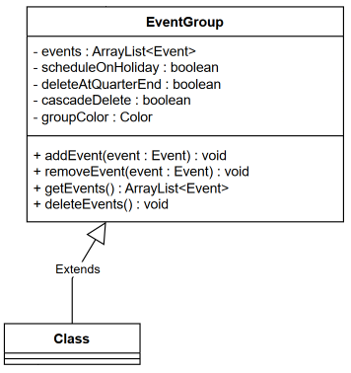
Software Implementation

Slide 35
Daily View
View Daily View
User can view the daily schedule at the bottom of the map page
View Extended Daily View
User can view the extended daily schedule by swiping up on the daily schedule

Slide 36
GUI

Slide 37
Weekly and Monthly View
View Weekly View
User can view the weekly schedule using the schedule screen
Select Event
User can click an event in the weekly schedule to go to its event information page
View Monthly View
User can view the monthly calendar schedule from the schedule screen
View Date information
User can click a specific date and see all events scheduled for that day
Select Event by Date
User can view the event information screen of an event on a specific date by clicking the desired date, then clicking the desired event.

Slide 38
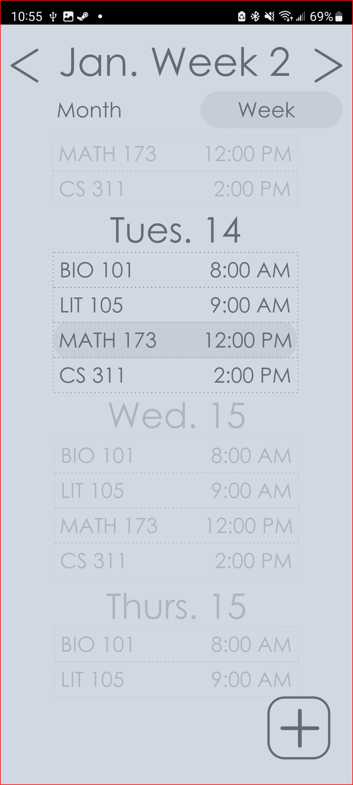
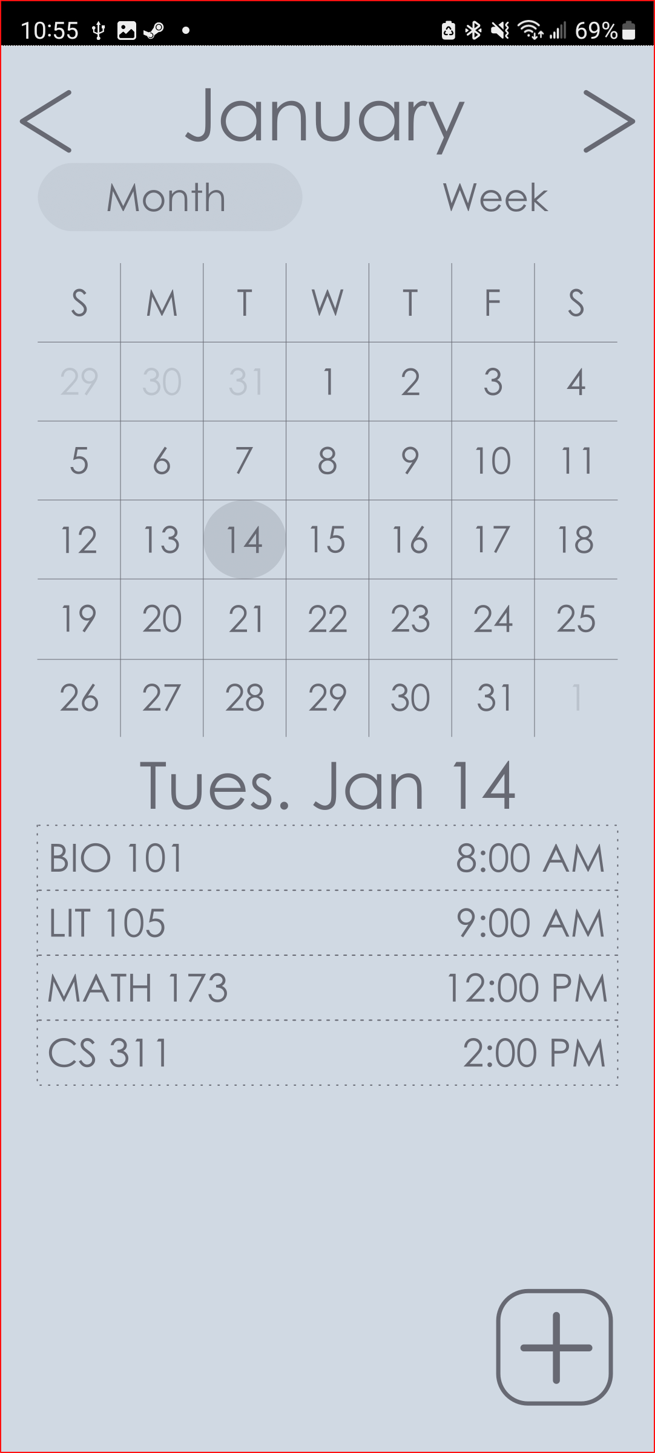
GUI

Slide 39
Interfaces
External
Google Maps API
The app will use the Google Maps API to get the map of the CWU campus and to find routes between destinations
Firebase API(s)
The app will use the Firebase APIs to store and retrieve data to/from the Firestore database, manage session tokens, validate email addresses
Google Calendar API
The app will use the Google Calendar API to import events from the users Google Calendar if they desire
Internal
Notification API
The app will send notifications about scheduled events to the user
GPS API
The app will use the users current GPS location to locate them on the map

Slide 40
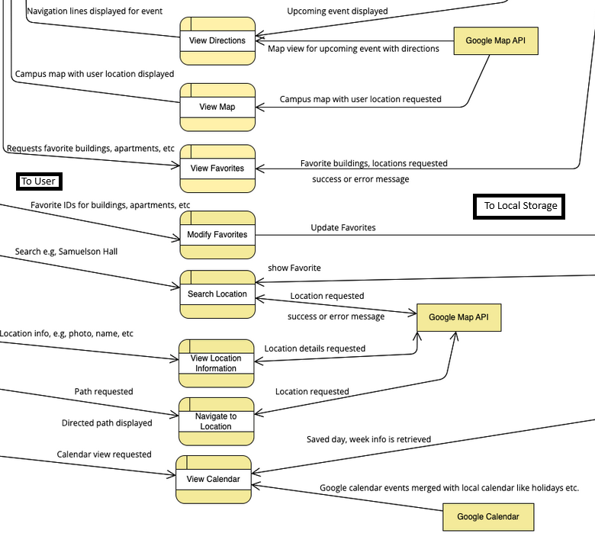
Software Implementation

Slide 41
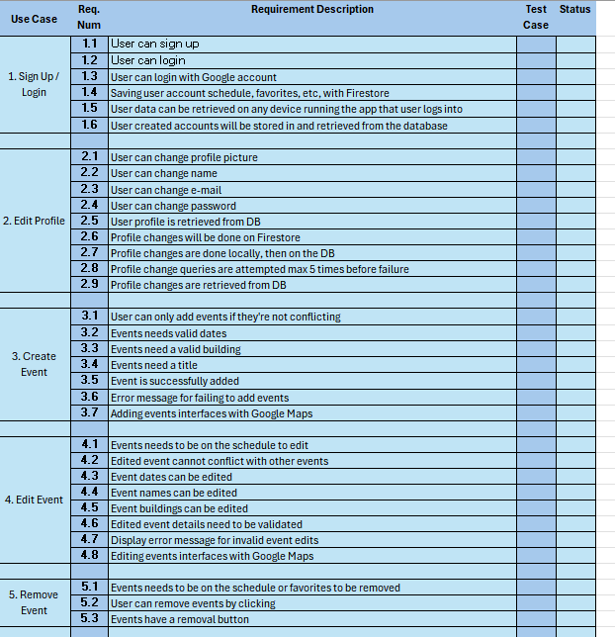
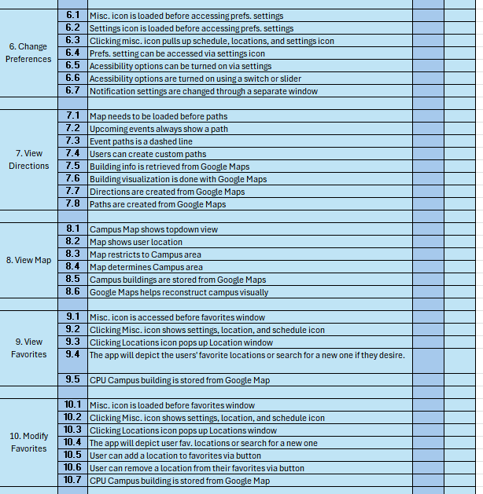
Traceability Matrix part 1

Slide 42
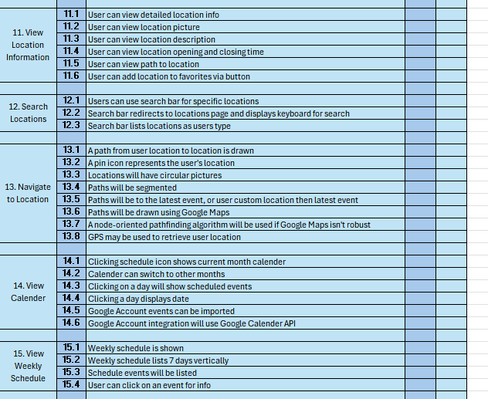
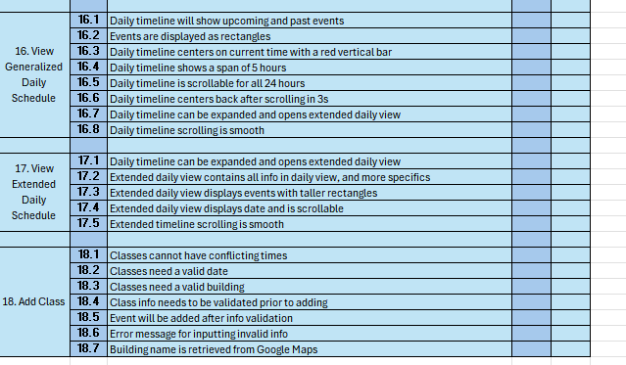
Traceability Matrix part 2

Slide 43
Fin!
Questions?

